Slide 1

T
CUAI 스터디 CS224N팀
2023.05.23
발표자 : 설지환, 원동연

Slide 2
스터디원 소개 및 만남 인증
스터디원 1 : 최동욱
스터디원 2 : 김건호
스터디원 3 : 설지환
스터디원 4 : 원동연

Slide 3
목차
Recurrence to Attention
Self-attention & Transformer
And Pretraining

Slide 4
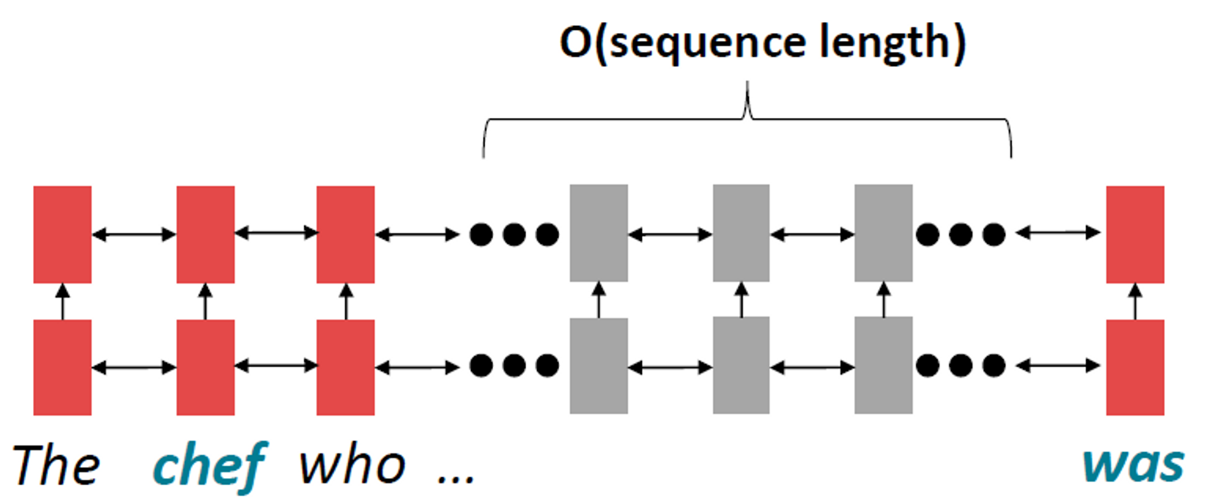
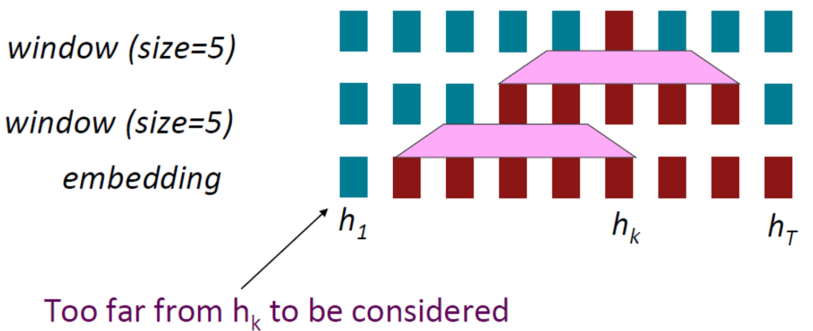
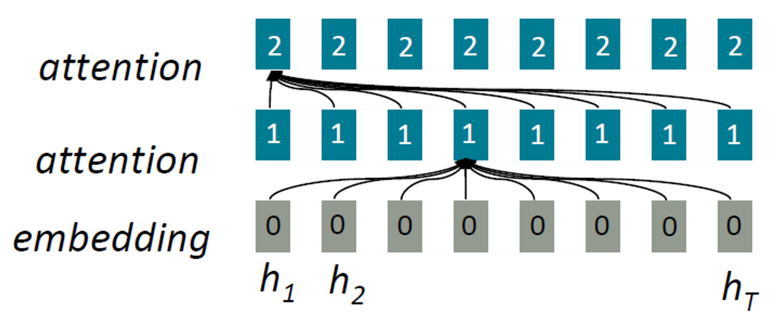
Recurrence to Attention
Linear Interaction Distance Word Windows
+ Lack of Parallelizability
Attention

Slide 5
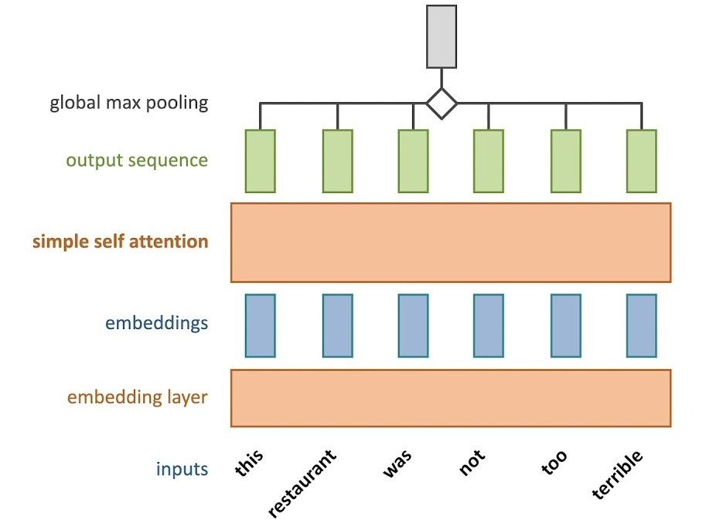
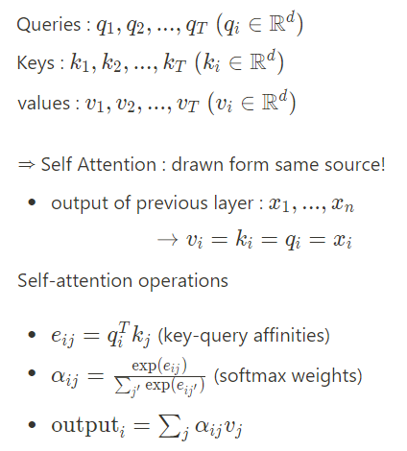
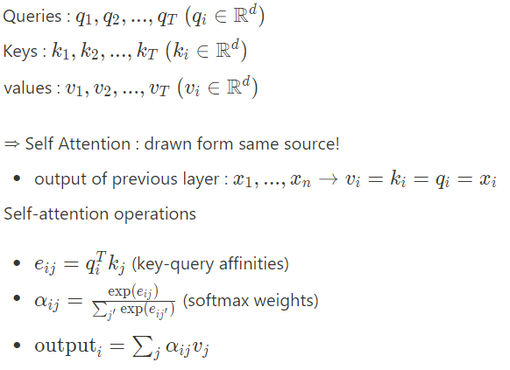
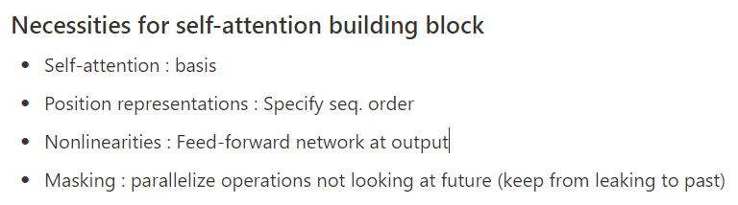
Self-Attention and Transformer
Self-Attention

Slide 6
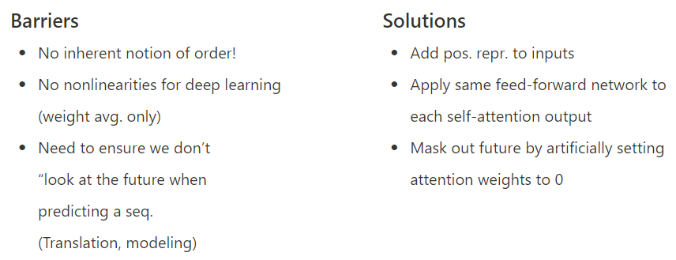
Self-Attention and Transformer
Self-Attention as NLP Building Block

Slide 7
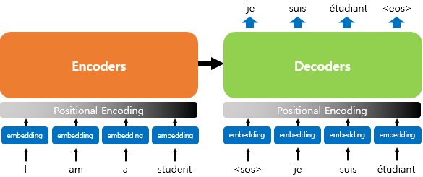
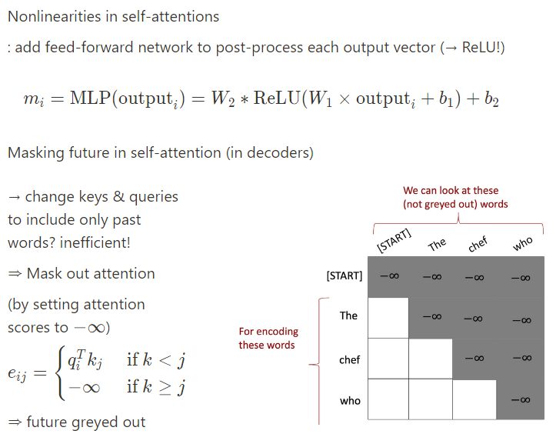
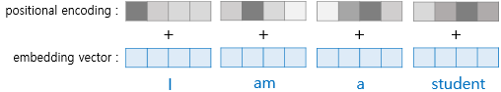
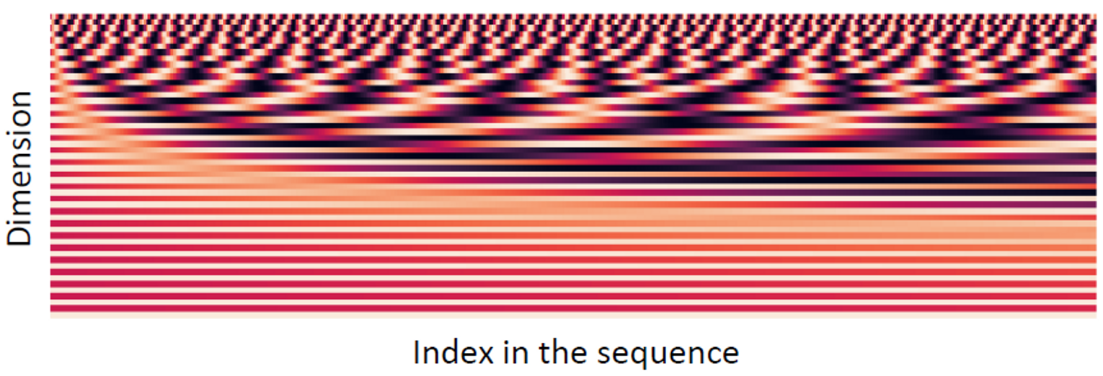
Self-Attention and Transformer
Positional Representations Nonlinearities, Masking future

Slide 8
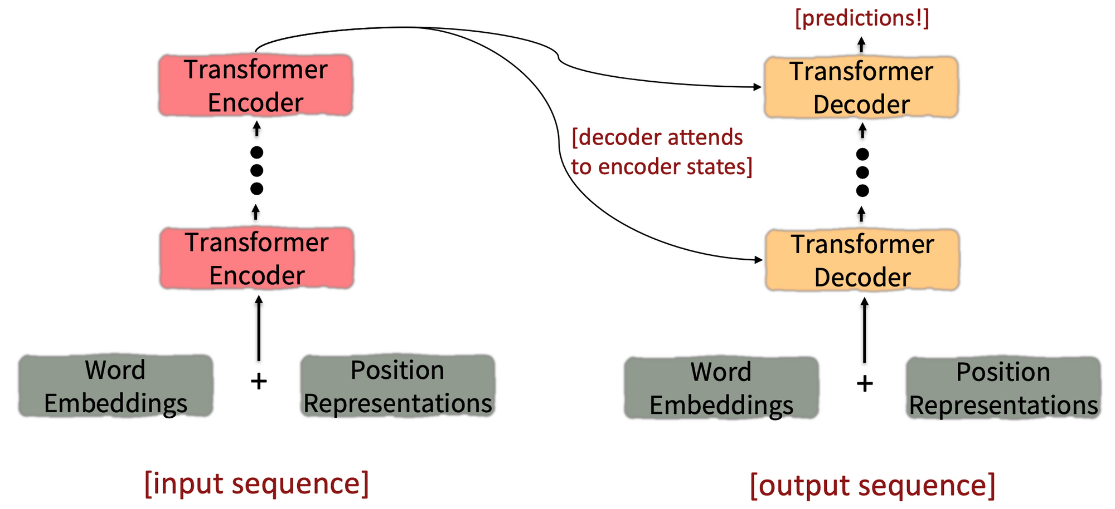
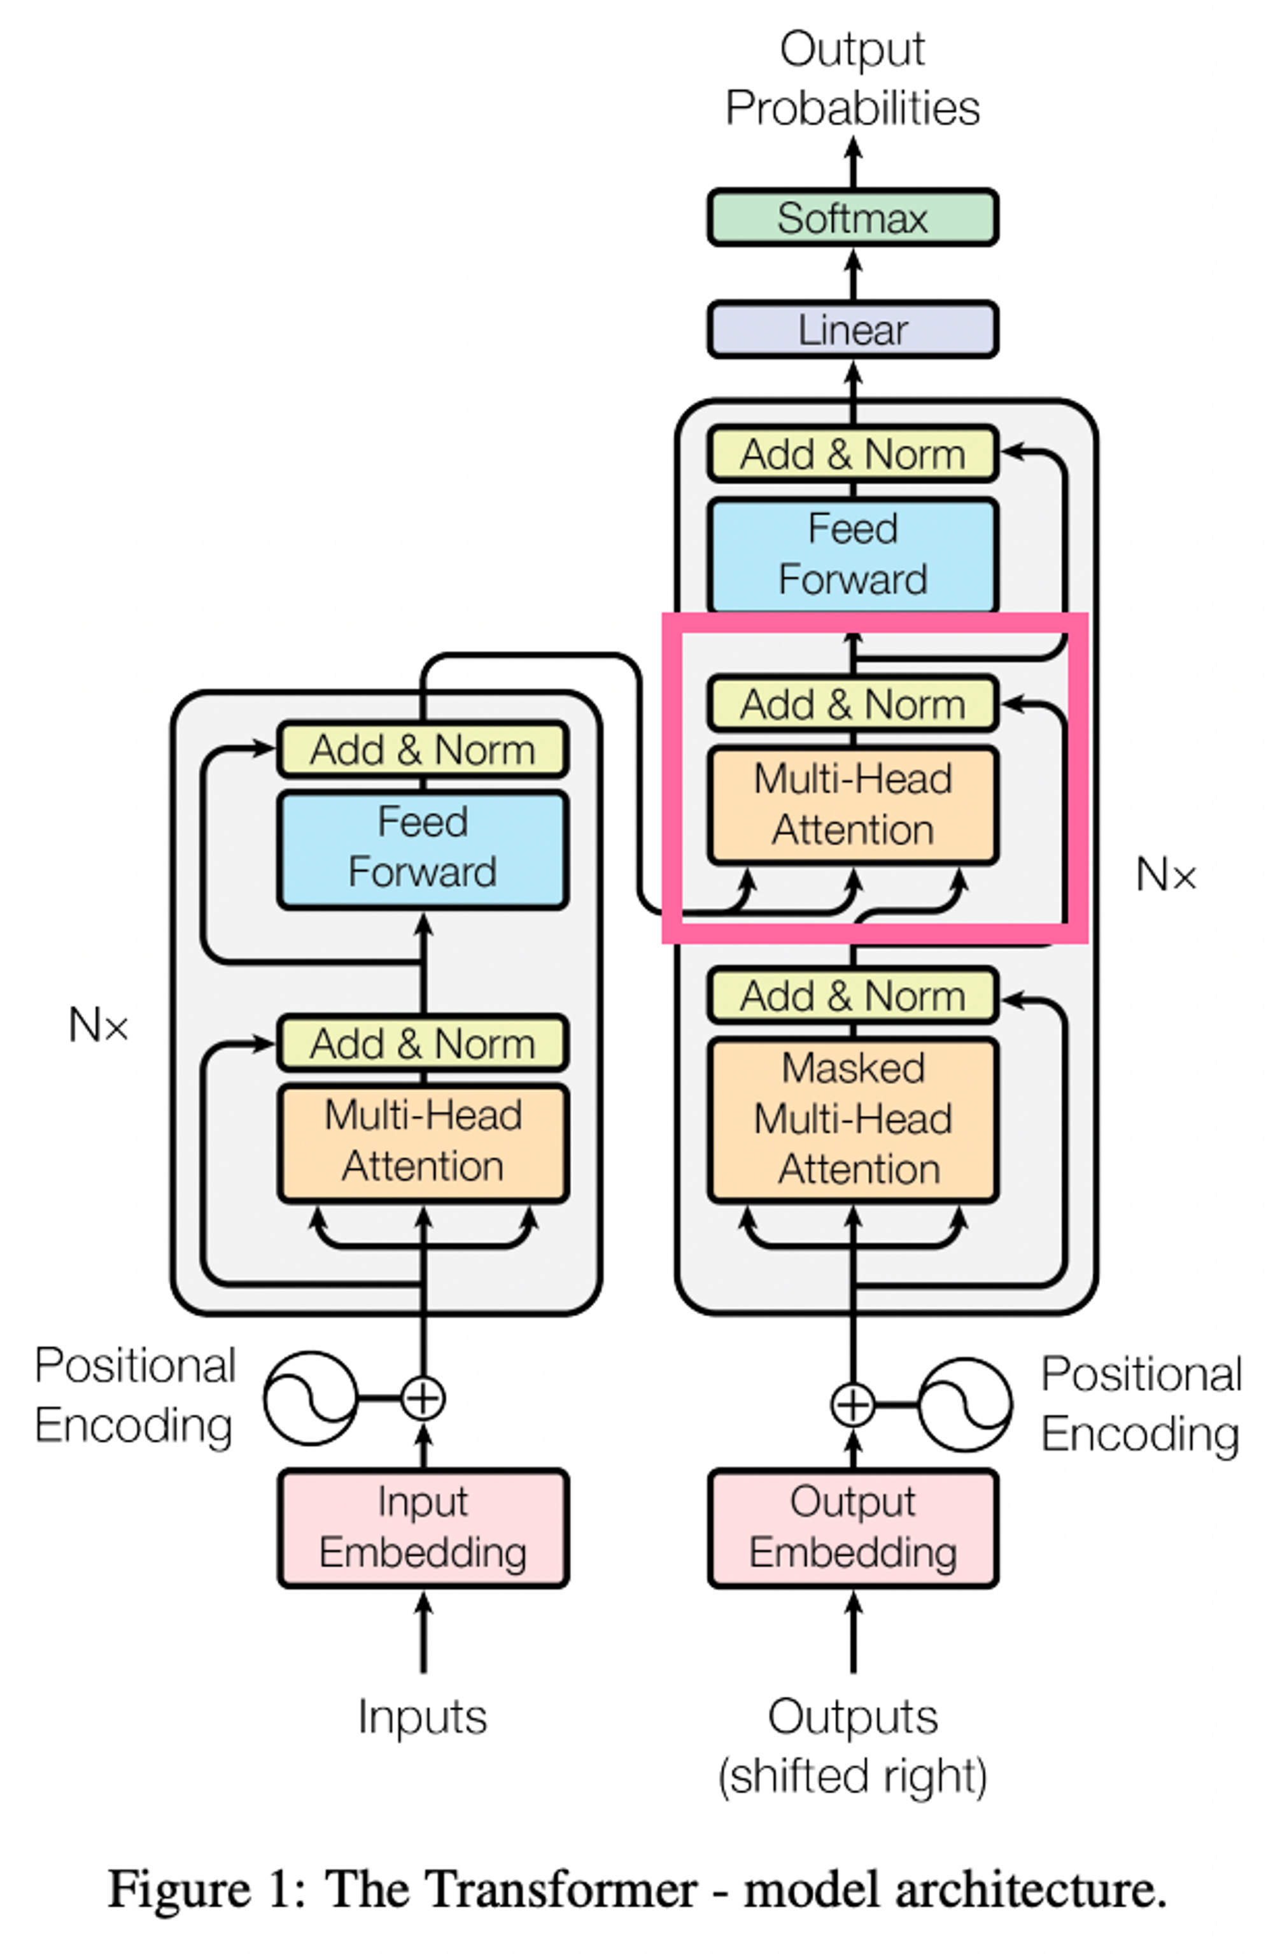
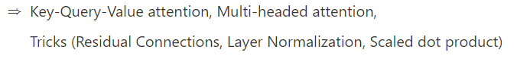
Self-Attention and Transformer
Transformer

Slide 9
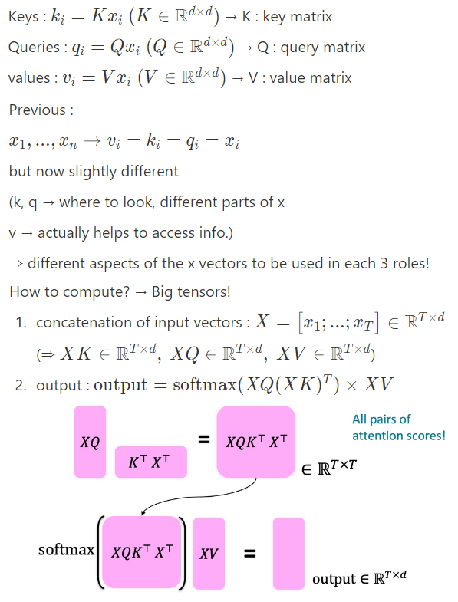
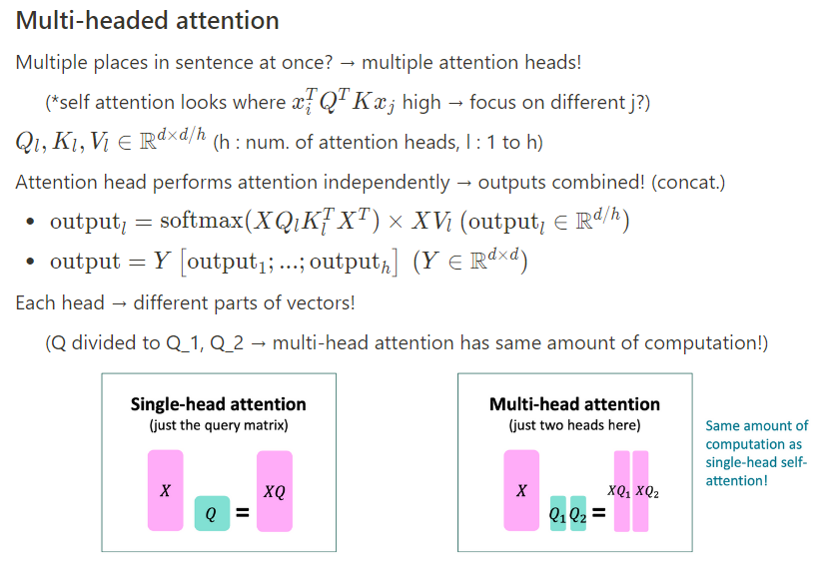
Self-Attention and Transformer
Key-Query-Value attention Multi-headed attention

Slide 10
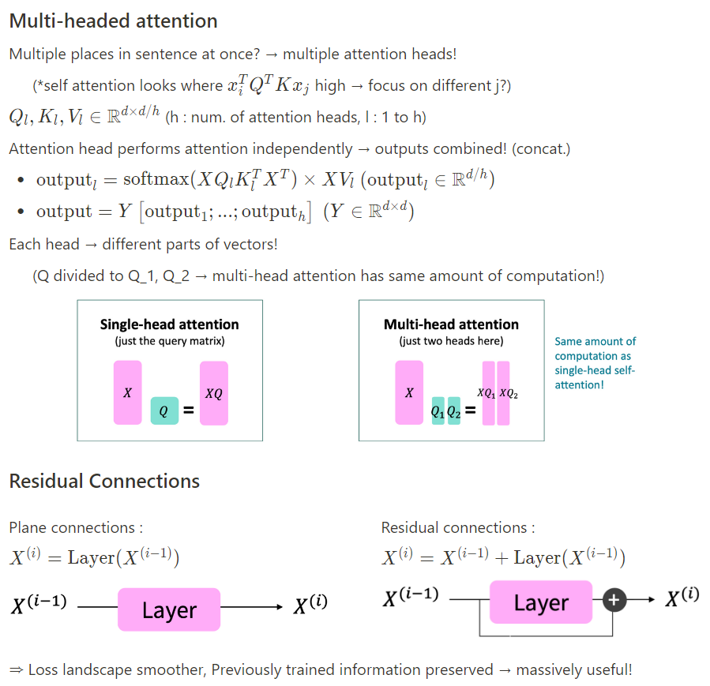
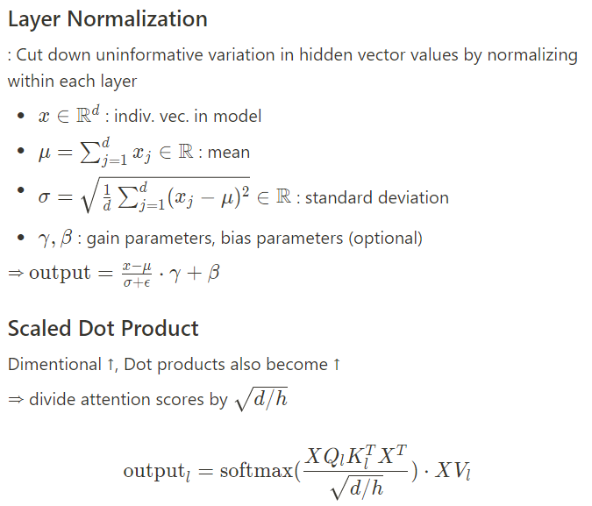
Self-Attention and Transformer
Multi-headed attention Layer Normalization
Residual Connections Scaled Dot Product

Slide 11
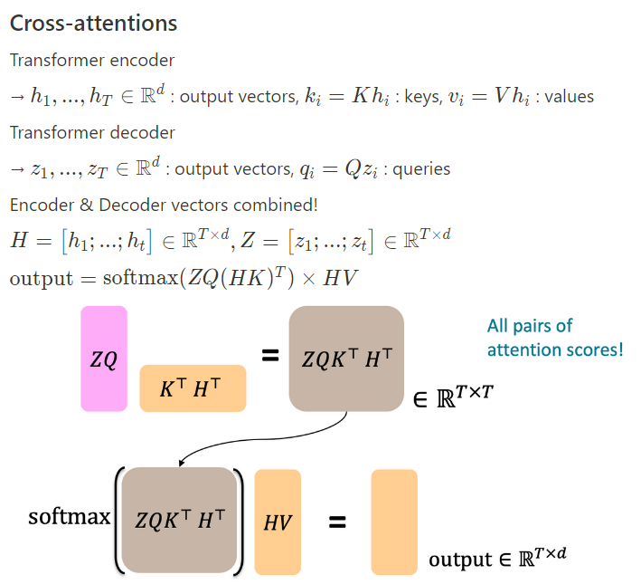
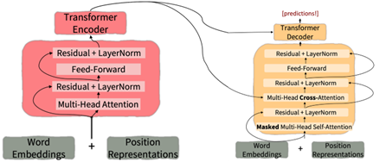
Self-Attention and Transformer
Cross-attentions Overall Insight

Slide 12
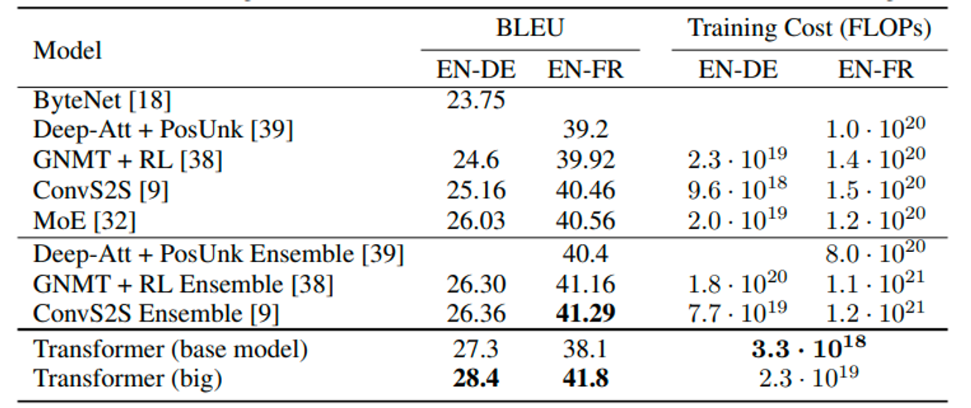
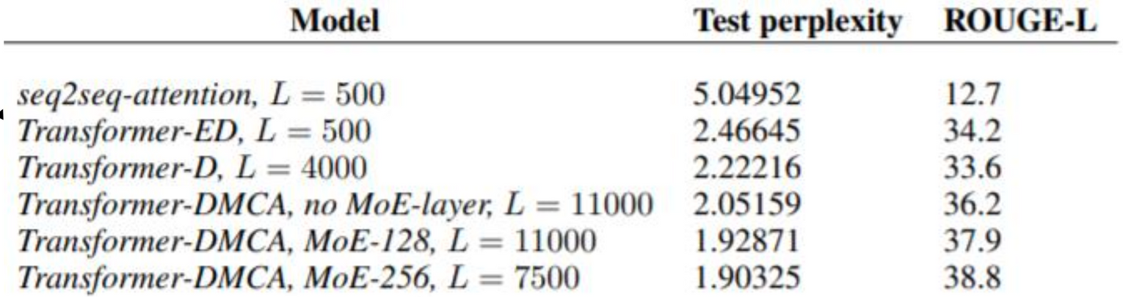
Self-Attention and Transformer
Results
Machine Translations
Higher BLEU scores
Document Generation
Transformers >> seq2seq
Pretraining
→ De facto standard!

Slide 13
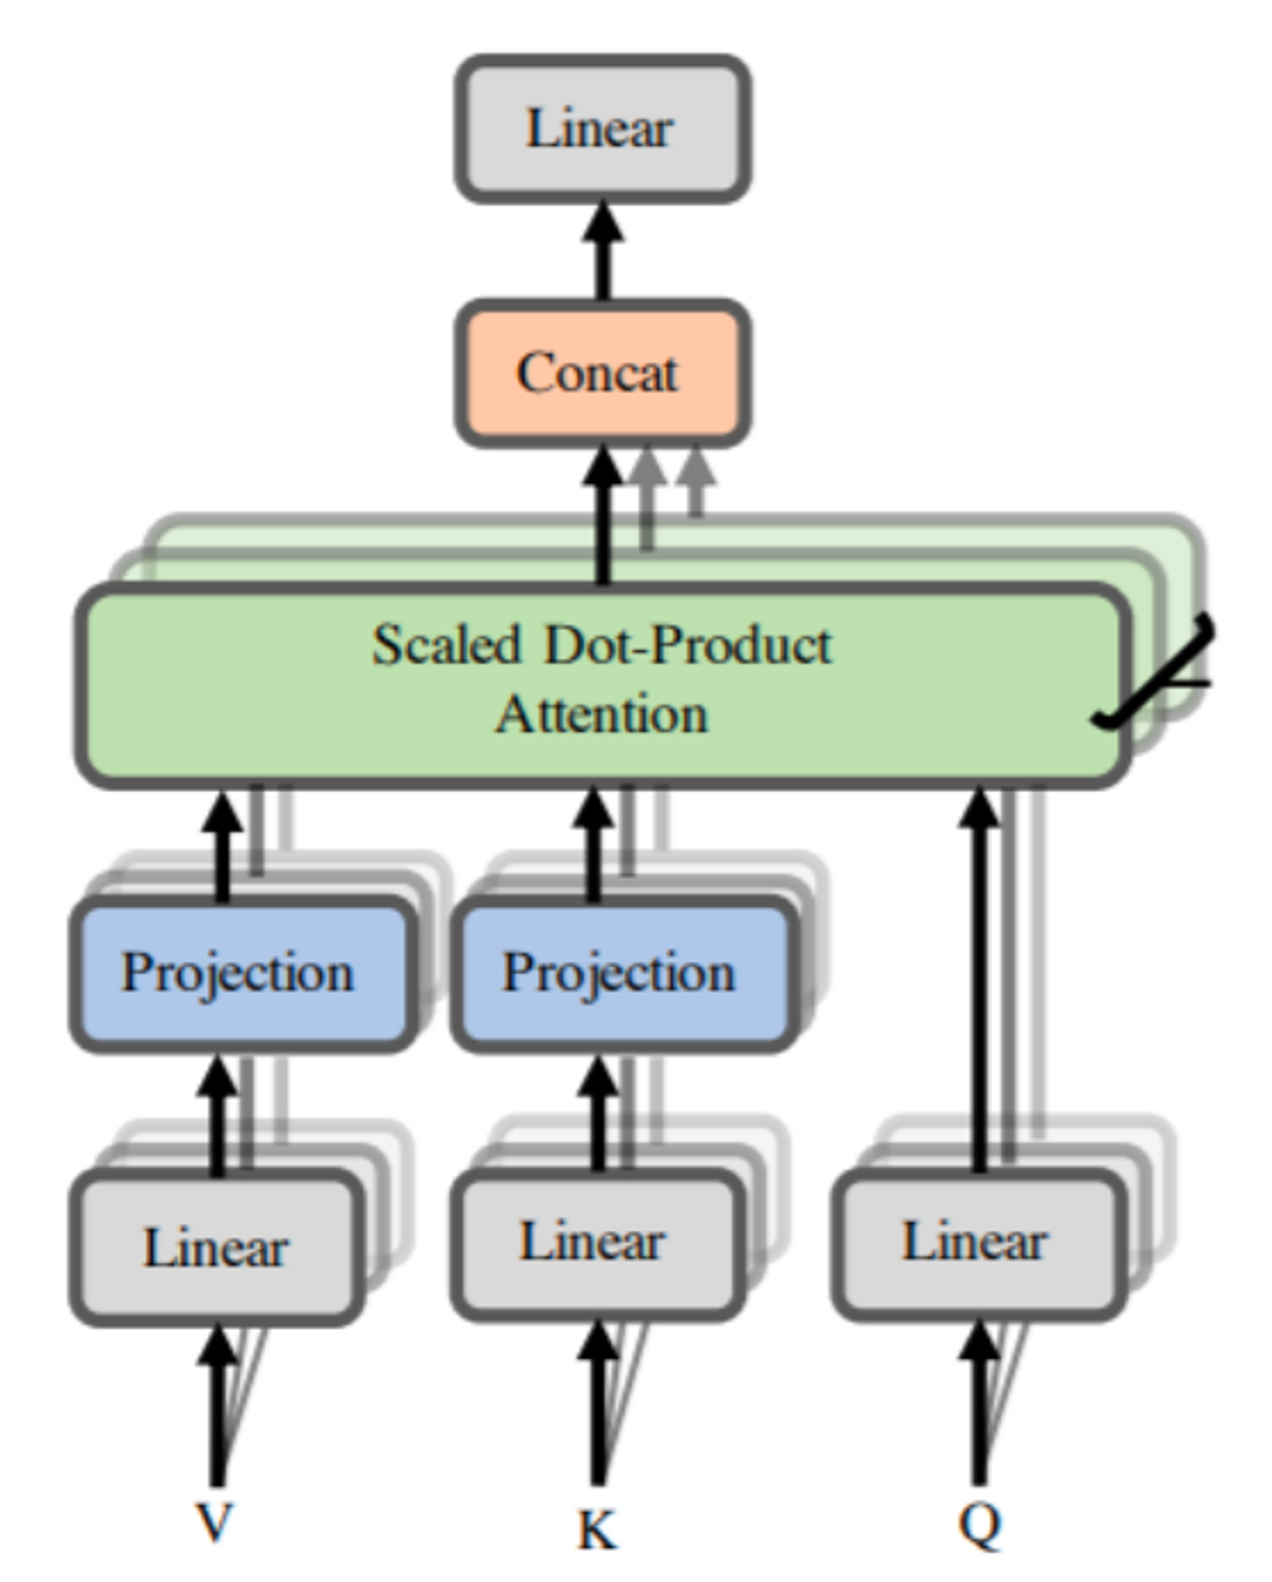
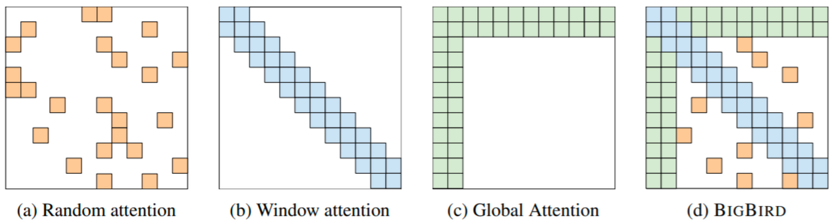
Self-Attention and Transformer
Variants
Linformer
map the sequence length dimension to a lower dimensional space for values, keys
Bigbird
Key idea: replace all pairs interactions with a family of other interactions, like local windows , looking at everything , and random interactions

Slide 14

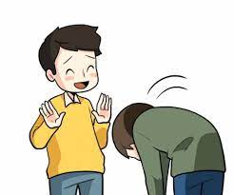
Pretraining
사과
∴ Word Embedding with Context

Slide 15
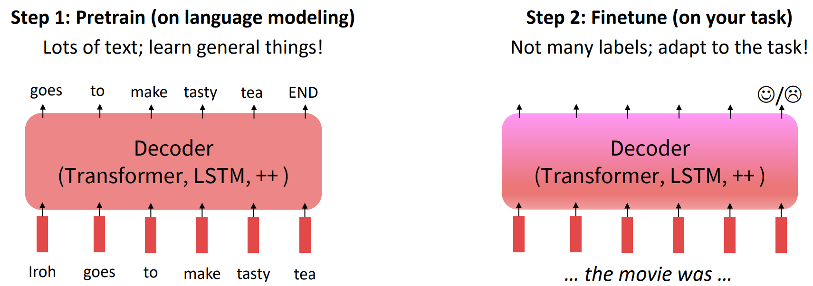
Pretraining
사전 학습
미세 조정

Slide 16
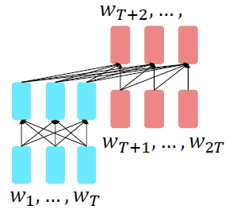
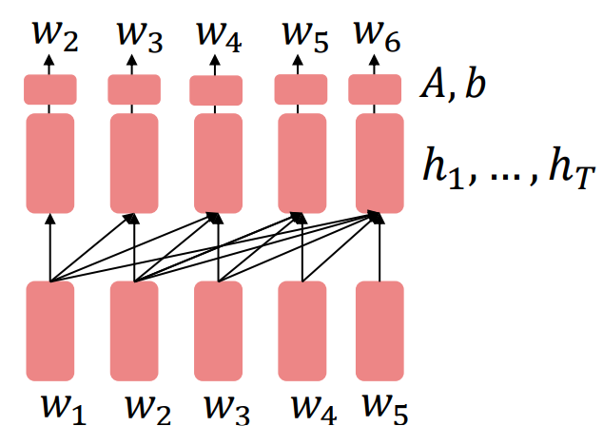
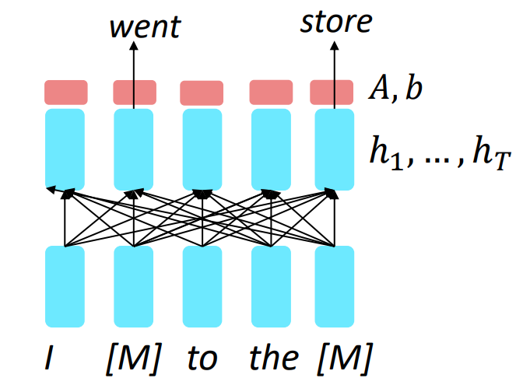
Pretraining Model
Decoder
- GPT-1
Encoder
- BERT
Encoder-Decoder
- T5

